Slide 1
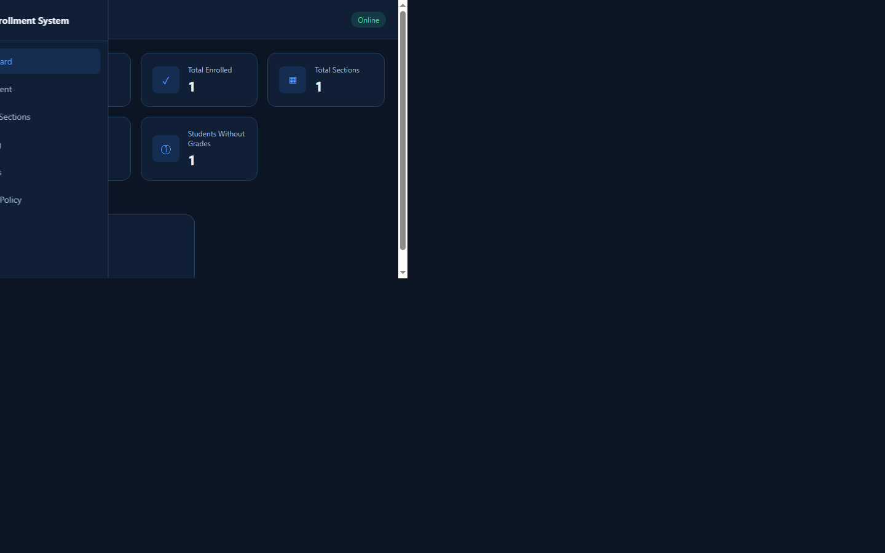
PROJECT PRESENTATION
School Enrollment
and Grading
Management System
A web-based Admin system for student records, sections, and grades
ADMIN DASHBOARD
Presented by: [GROUP NAME NATEN LAGAY MO)]
[Course / Section] | [PANGALAN NI SIR AT SECTION NATIN LAGAY KA] | [DATE]
Notes:
Good day, everyone. We are here to present our School Enrollment and Grading Management System. It helps an administrator organize student records, school sections, and grades. I am [name], together with [group members], from [course and section].

Slide 2
01 / OVERVIEW
One place to manage school records
A focused Admin workflow backed by Google Sheets.
WHAT THE SYSTEM DOES
- Manages student records
- Assigns students to school sections
- Records and validates grades
- Configures school year, subjects, and passing grade
PRIMARY USER
Administrator / Registrar
SCHOOL ENROLLMENT & GRADING MANAGEMENT SYSTEM
02
Notes:
Our system is a web-based application for the school administrator or registrar. It provides one place to manage student information, assign students to sections, and record grades. Students are entered by the administrator; this version does not have student self-registration.

Slide 3
02 / PURPOSE
From manual records to an organized workflow
The project focuses on accuracy, traceability, and simpler administration.
THE PROBLEM
PROJECT OBJECTIVES
Manual records take time.
Information can be hard to track.
Grade entry can introduce errors.
Organize student records
Manage section assignments
Validate grades from 0 to 100
Show useful dashboard statistics
SCHOOL ENROLLMENT & GRADING MANAGEMENT SYSTEM
03
Notes:
Managing student records manually can take time and make information harder to track. Section assignments and grades may become inconsistent when they are kept in separate files. Our objectives were to organize student records, manage sections, validate grades, and provide an administrator dashboard.

Slide 4
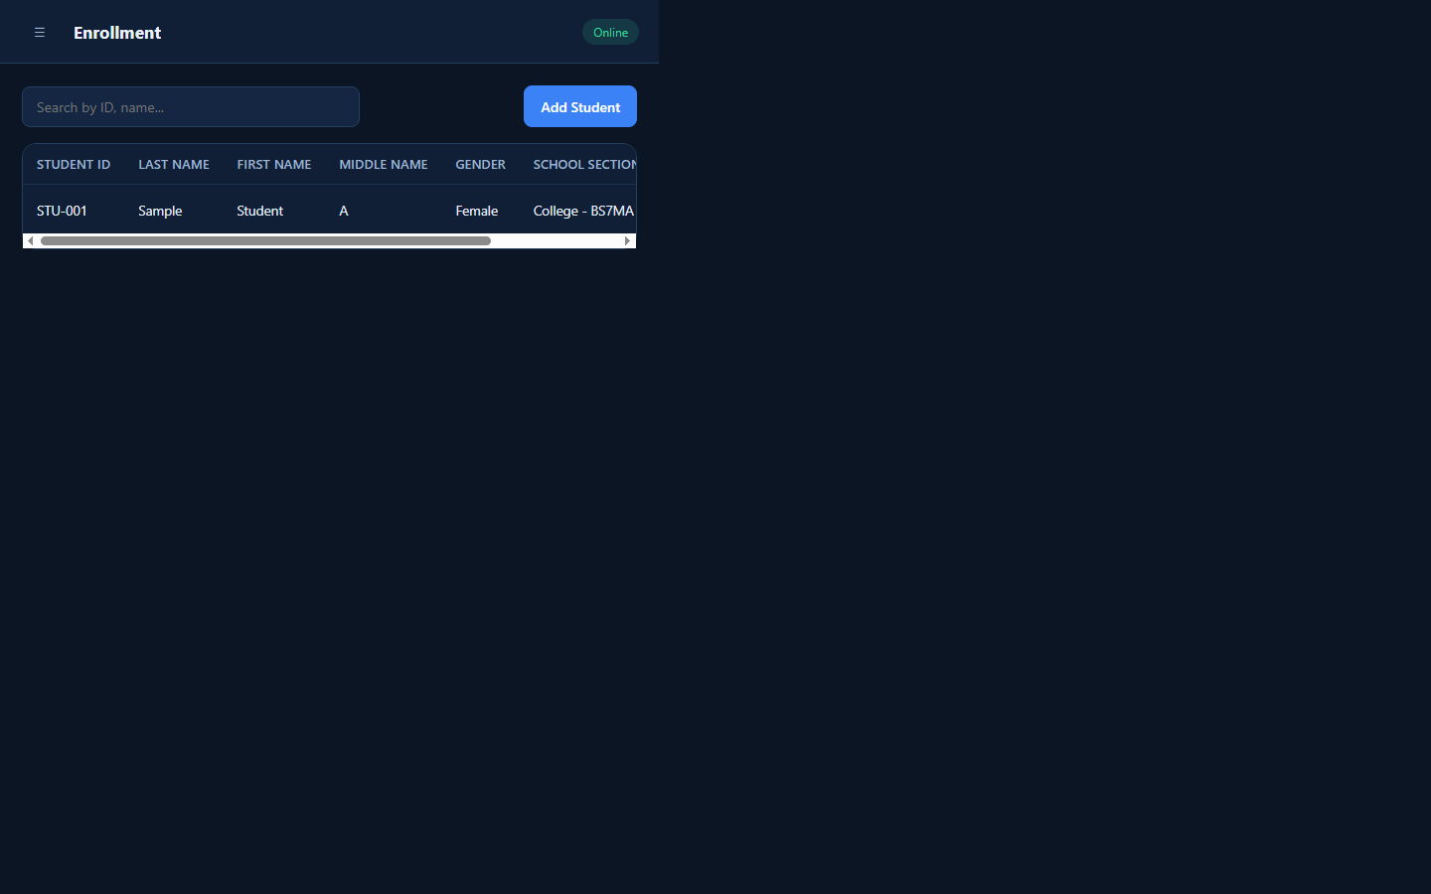
03 / CAPABILITIES
Admin tools for enrollment and grading
One administrator role manages the school data.
ADMIN
Login and dashboard
Student add, edit, search, transfer
Section add, edit, archive or remove
Grade entry, averages, and remarks
School settings
ENROLLMENT
SCHOOL ENROLLMENT & GRADING MANAGEMENT SYSTEM
04
Notes:
The main user is the administrator or registrar. The Admin can view dashboard statistics, add and edit students, search records, transfer students between sections, manage sections, enter grades, and update school settings. Students are records managed by the Admin, not separate system users.

Slide 5
04 / ARCHITECTURE
A simple three-layer architecture
The browser never connects directly to the spreadsheet.
ADMIN
>
WEB FRONT END
>
APPS SCRIPT API
Uses the system
HTML / CSS / JavaScript
Authentication / validation / operations
v
GOOGLE SHEETS DATABASE
Users / Students / Sections / Grades / Settings
SCHOOL ENROLLMENT & GRADING MANAGEMENT SYSTEM
05
Notes:
The system has three main parts. HTML, CSS, and JavaScript display the interface. Google Apps Script processes requests and enforces backend rules. Google Sheets stores the records. The browser talks to Apps Script, and Apps Script reads or updates the spreadsheet.

Slide 6
05 / DATA
Spreadsheet tables keep records organized
Each sheet has a focused responsibility.
USERS
STUDENTS
SECTIONS
Admin account, role, status
Student details and section
Grade level, name, status
GRADES
SETTINGS
ACTIVITY LOGS
Subject grade and academic period
School, year, subjects, passing grade
Recorded system activities
SCHOOL ENROLLMENT & GRADING MANAGEMENT SYSTEM
06
Notes:
Google Sheets is used as the project database. Users stores Admin account information. Students holds student details and section assignments. Sections stores grade levels and section names. Grades stores subject grades. Settings stores the current school configuration. ActivityLogs records system actions.

Slide 7
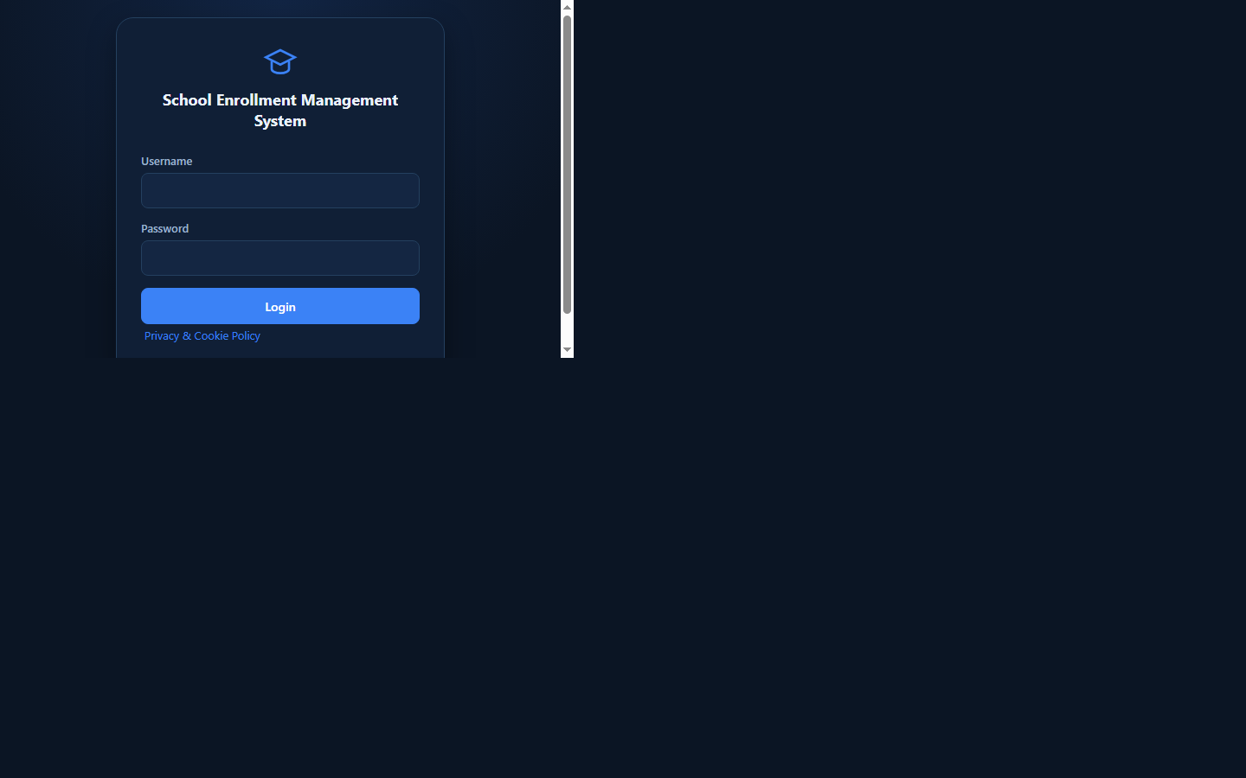
06 / INTERFACE
The system interface
Actual application screenshots; the enrollment screenshot uses anonymized demo text.
ADMIN LOGIN
DASHBOARD
SCHOOL ENROLLMENT & GRADING MANAGEMENT SYSTEM
07
Notes:
These screenshots show the actual Admin login page and dashboard. The dashboard displays student, enrollment, section, and grading totals. Student details shown elsewhere in this deck have been anonymized for presentation.

Slide 8
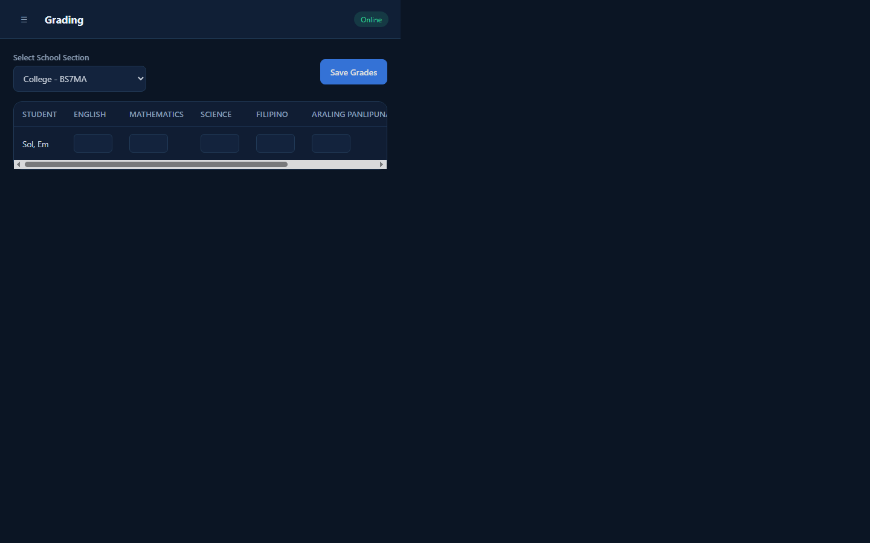
07 / DEMONSTRATION
A complete Admin workflow
Demonstrate these steps in the live system.
01
LOGIN
02
ENROLL
03
GRADE
04
CONFIGURE
Admin authentication
Add student and section
Enter and save grades
Update school settings
Admin login > Dashboard > Add student > Assign section > Enter grades > Save settings
SCHOOL ENROLLMENT & GRADING MANAGEMENT SYSTEM
08
Notes:
We will demonstrate the actual workflow. First, the administrator logs in. From Enrollment, the administrator adds a student and assigns a section. In Grading, the administrator selects a section, enters grades, and saves them. The system calculates averages and remarks. We will also show Settings.

Slide 9
08 / ENGINEERING
Challenges addressed in the project
Examples based on issues encountered while building this system.
CHALLENGE
SOLUTION
Duplicate student records
Validate Student ID before saving
Invalid grade values
Enforce the 0 to 100 grade range
Unauthorized access
Require an active Admin session on backend
Section deletion risk
Archive sections with students or grades
Settings not saving
Fix button loading state and API persistence
SCHOOL ENROLLMENT & GRADING MANAGEMENT SYSTEM
09
Notes:
We encountered issues including duplicate student records, invalid grade input, unauthorized access risks, and the risk of breaking records when deleting sections. We added validation, Admin-only backend checks, and section archiving. We also corrected a loading UI issue that prevented Settings from saving.

Slide 10
09 / CONCLUSION
A more organized way
to manage school records.
FUTURE
IMPROVEMENTS
Printable reports
Data export and backup
Additional user roles
Student or teacher portals
Centralized student, section, and grade management
Admin-controlled workflow with backend validation
Built with HTML, JavaScript, Apps Script, and Google Sheets
THANK YOU
Questions?
Notes:
To conclude, our system gives administrators an organized way to manage student records, sections, and grades. The project helped us apply front-end development, backend services, and database concepts. Future improvements could include printable reports, data export, backups, and additional user roles. Thank you. We are ready for questions.

